Slide 1
Celestica IR 4.0 Project (Update Ver 2.0)
Production Report Automation and Dashboard Viewer

Slide 2
Introduction
| Problem Statement | Solution | Benefit
Reduce possibilities of error in reporting.
Manaul reporting data collecting- Could lead to deviated reports anylysis
Reduce non-value added job/task.
Previous workflow:- Supervisor will key in manually the data to the report.
Solution :- Data will automatically be fetched at the HP Server Database and automatically generate production report (report automation).
Benefits:- Reduce non-value added work.
Higher data accuracy - Data from the server will be more accurate and consistent

Slide 3
Content
Template Overview/ Reports Template/Engineering Dashboard
Leveraging Plan
Challange

Slide 4
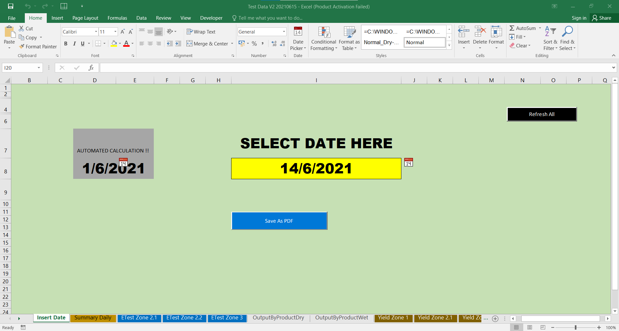
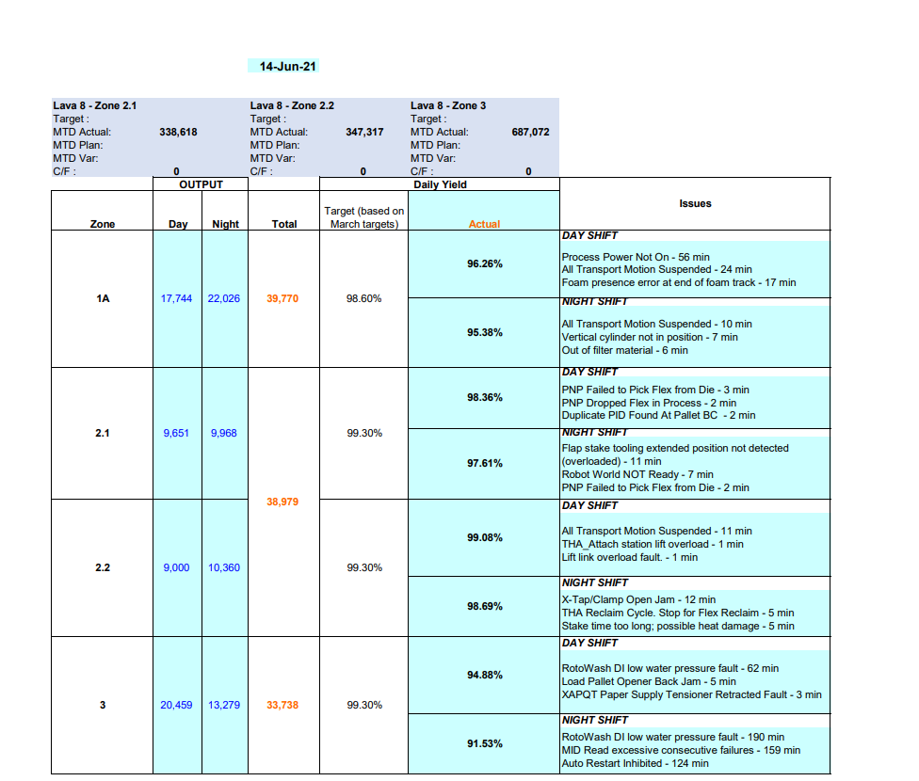
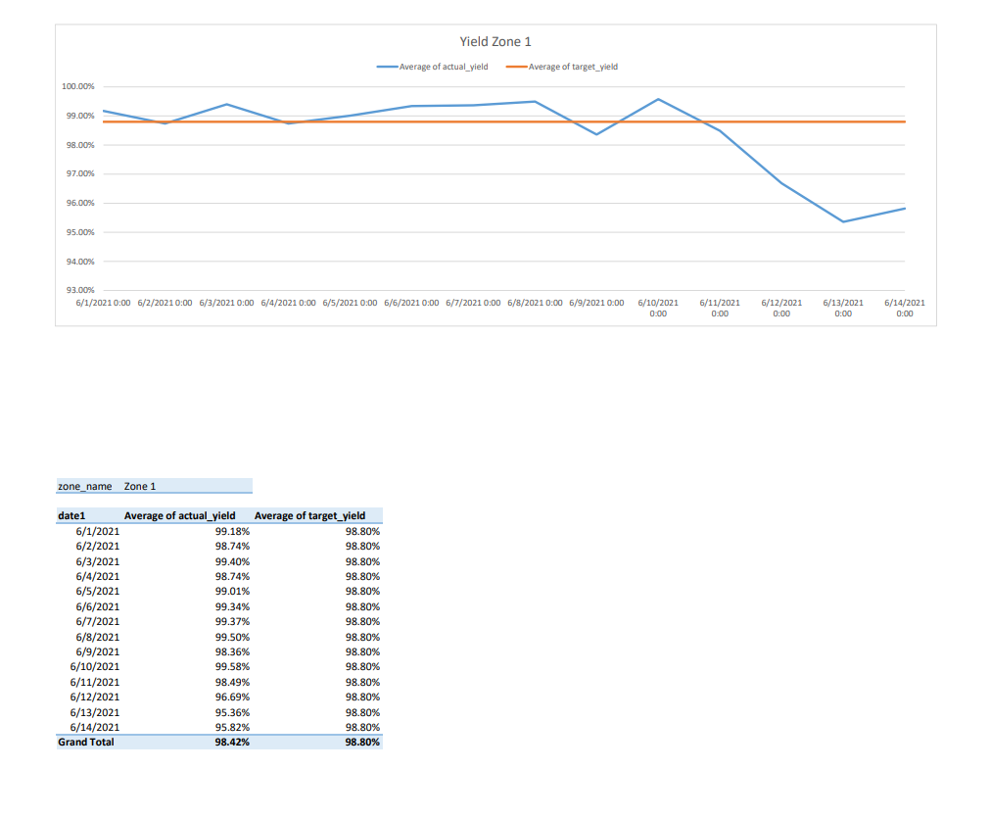
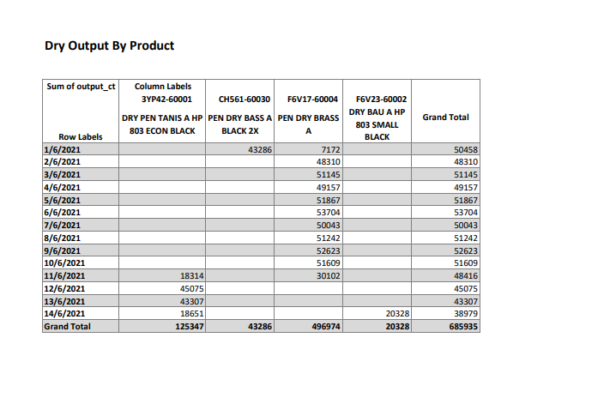
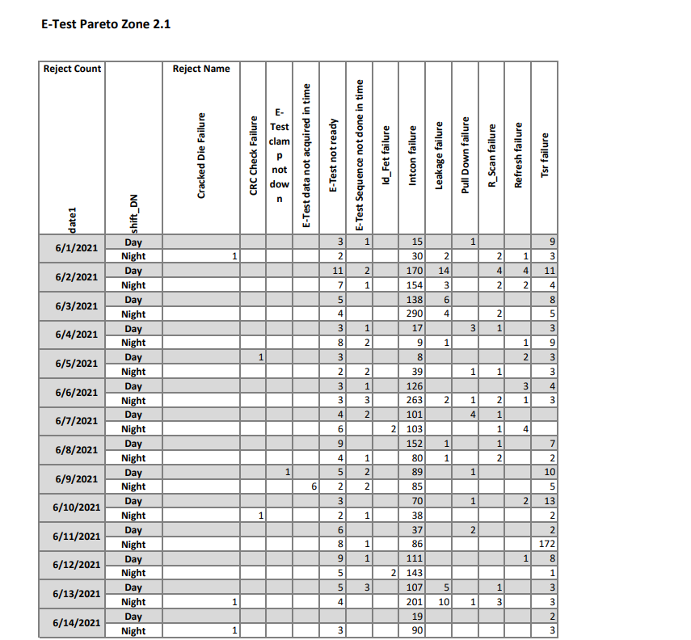
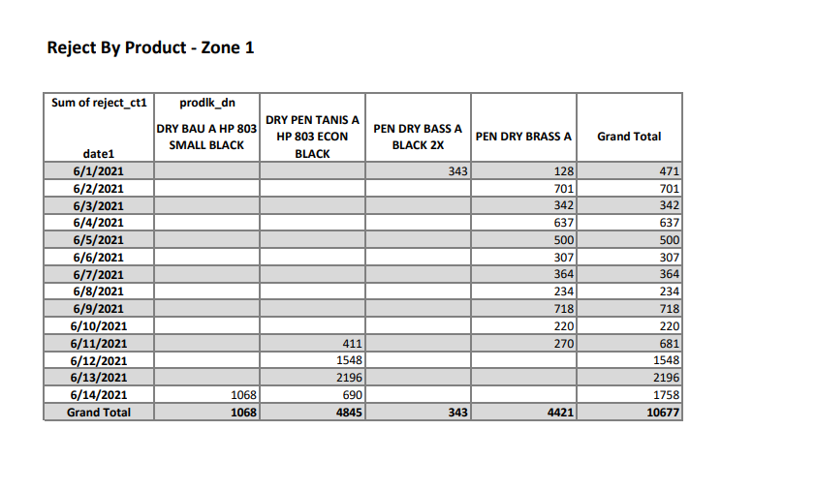
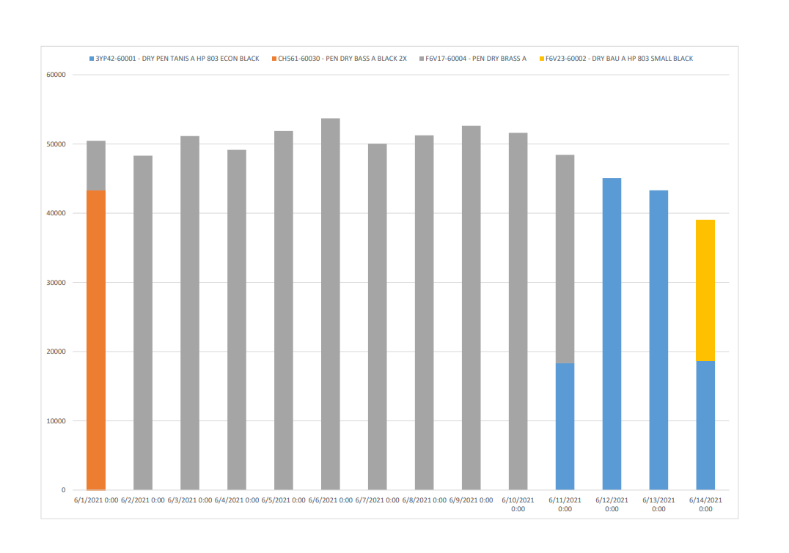
Template Overview
Daily Summary
1. Choose the date of the report they want to generate in the template.
2
1
Yield Chart
2. Click ‘Refresh All’ button in order for the data to be fetch at the server.
3
Output by Product (Table)
3. Click ‘Save as PDF’ button to generate the report in PDF format.
Reject by Product
E-Test Pareto
Daily Summary

Slide 5
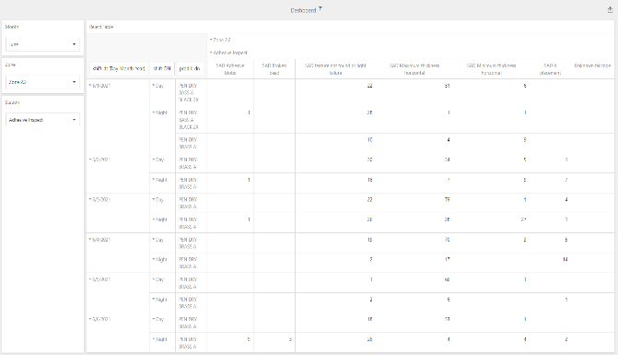
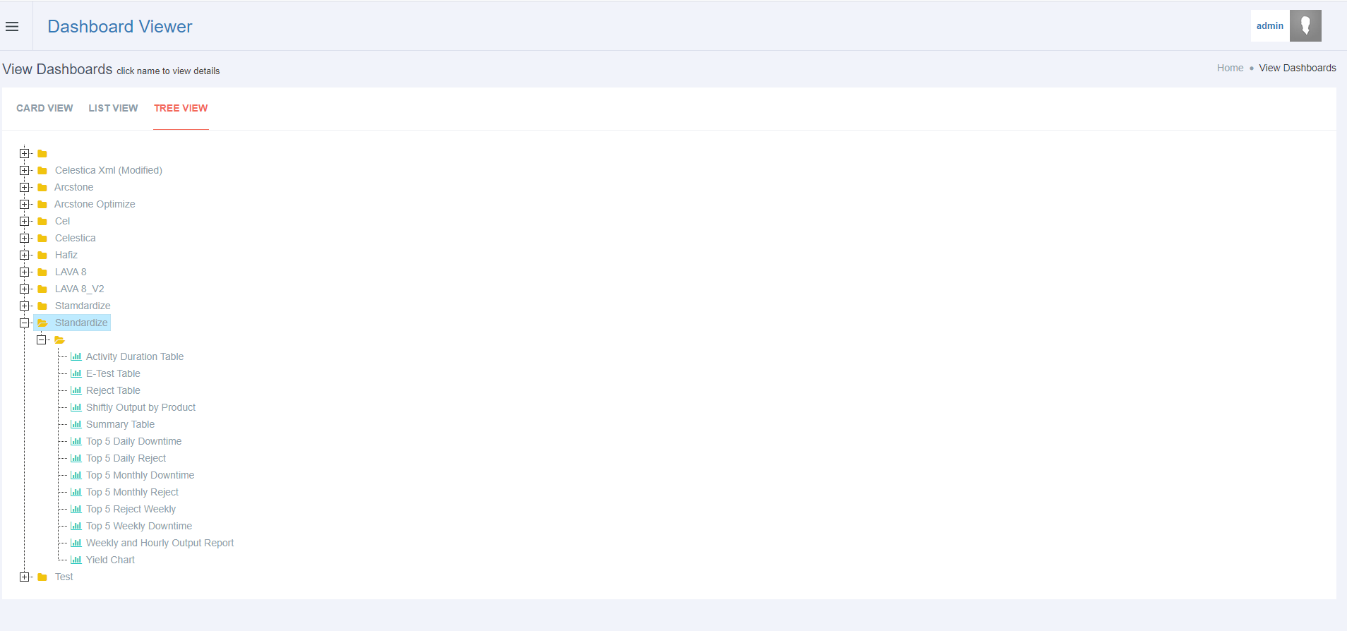
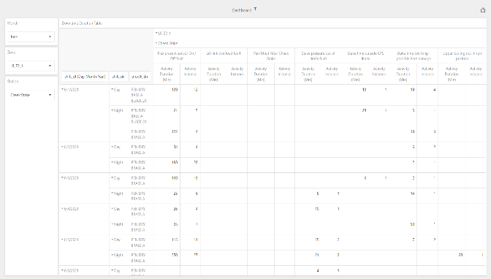
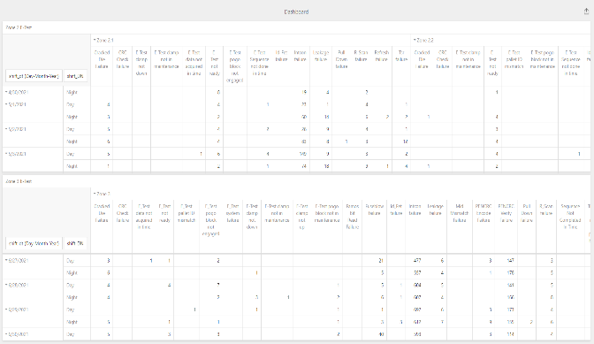
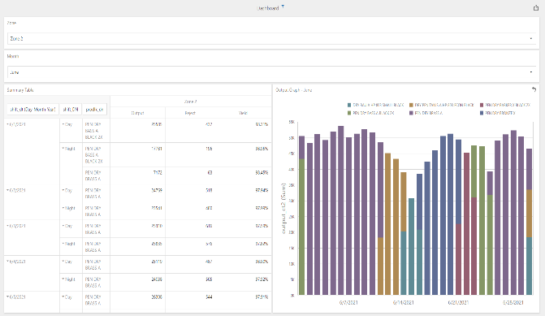
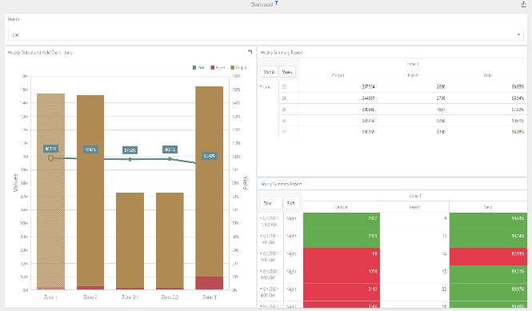
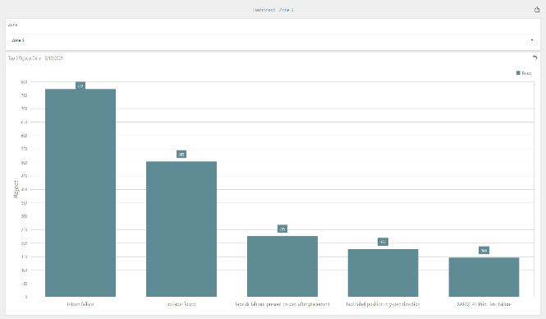
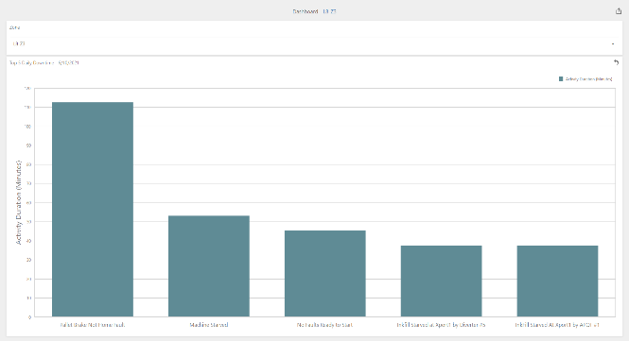
Engineering Dashboard
Reject Report
Downtime Report
E-Test Report
Output by Product(by shift)
Hourly and Weekly Output
Top 5 Daily Reject Report
Top 5 Daily Downtime Report

Slide 6
Leveraging Plan
Q3/Q4 ‘21 | Q1/2/3/4 ‘22
Implementation at Lava 8.(Pilot line) Continues and leverage Lava 24 database Study the requirement and information need to be implemented at other’s line. | Study and implement at other’s line which have the database required which at Lava 25,Lava 26, Magma 1 and Magma 3 Get the login credential and access support from HP for Lava 19,Lava 20, Lava 22 and Magma 4
L8 L24 L25 L26 M3 M1 M4 L22 L19 / L20 Orcus3
Production Reports
Dashboard Viewer
Q3 ‘21 Q4 ‘21/Q1 ’22/Q2 ‘22 Q2 ‘22/Q3 ‘22 Q3 ‘22/Q4 ‘22
Continues developing

Slide 7
Challenge
Limited understanding and knowledge of the database currently used.
Different line will have different issue that need to be dealt when the template is being implemented.
Not all line have the view database that can be used to gather necessary data such as database at Lava 8 and Lava 24. ( Access denied M3 and L19 for MYS110( P1), M4, M1, L22, L20 MYS 159 (P2/3)).
Magma and Lava, Fastlite and Warp9 may have some diference at backend.
Every line and module will have different equipment key.

Slide 8
Conclusion
Keep Improvement
More flexibility / visibility
Future Planning

Slide 9
Appendix

Slide 10
Project Timeline
LAVA 8
LAVA 26
MAGMA 4
LAVA 20
LAVA 24
LAVA 22
MAGMA 3
LAVA 25
MAGMA 1
LAVA 19

Slide 11
Current Project Progress

Slide 12
Production Report

Slide 13
Supervisor need to click this button the fetch the data from the server
Supervisor can choose date to generate the report
Supervisor can save the report in PDF format

Slide 14
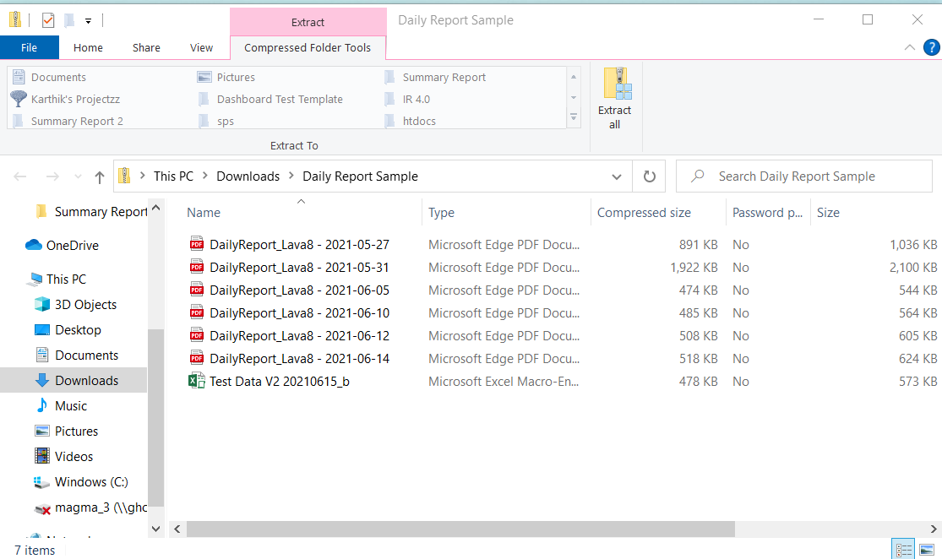
Generated Report in PDF format

Slide 15
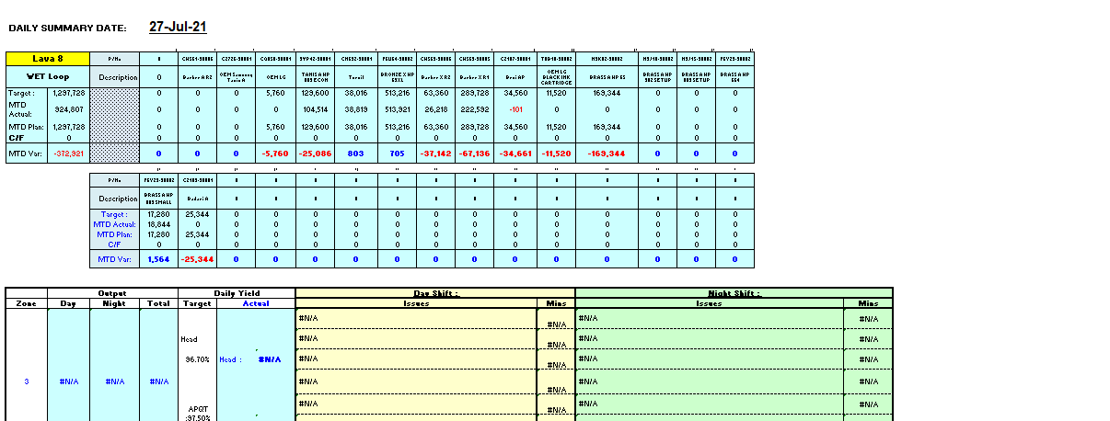
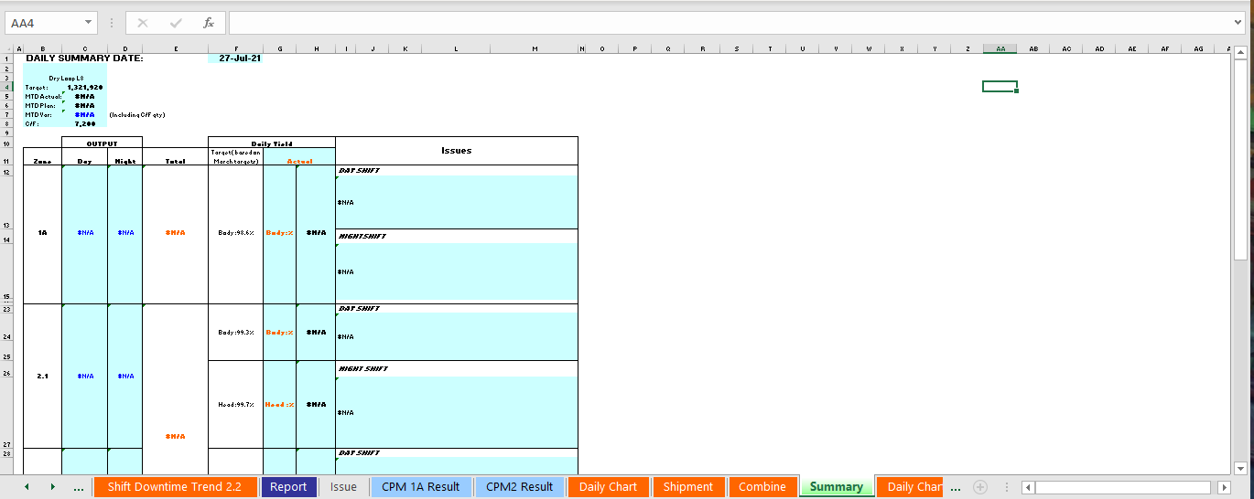
Summary Report (Current Report)

Slide 16
Summary Report (New Template)
Both for Dry and Wet Loop.
Combined both Dry and Wet Zone together in the same page

Slide 17
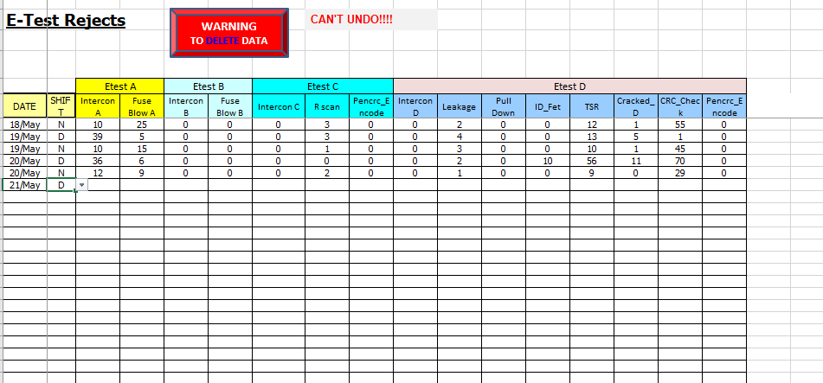
E-Test Pareto(Current Report)

Slide 18
E-Test Table (New Template)
Zone 2.1
Zone 2.2
Zone 3

Slide 19
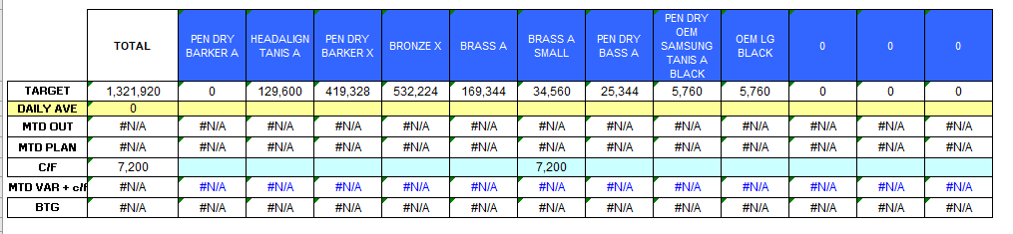
Cumulative Output by Product (Current Report)

Slide 20
Output by Product (Table) Template
Both for Dry and Wet Loop.
Include daily output by product and cumulative output by product.
Greater in detail of the daily output by product.

Slide 21
Output by Product(Graph) Template
Both for Dry and Wet Loop.

Slide 22
Reject by Product Template
Zone 1
Zone 2.1
Zone 2.2
Zone 3

Slide 23
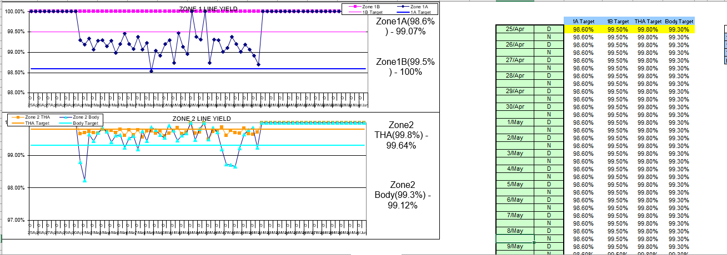
Yield Chart (Current Report)

Slide 24
Yield Chart Template
Zone 1
Zone 2 Overall
Zone 2.1
Zone 2.2
Zone 3

Slide 25
Engineering Dashboard

Slide 26
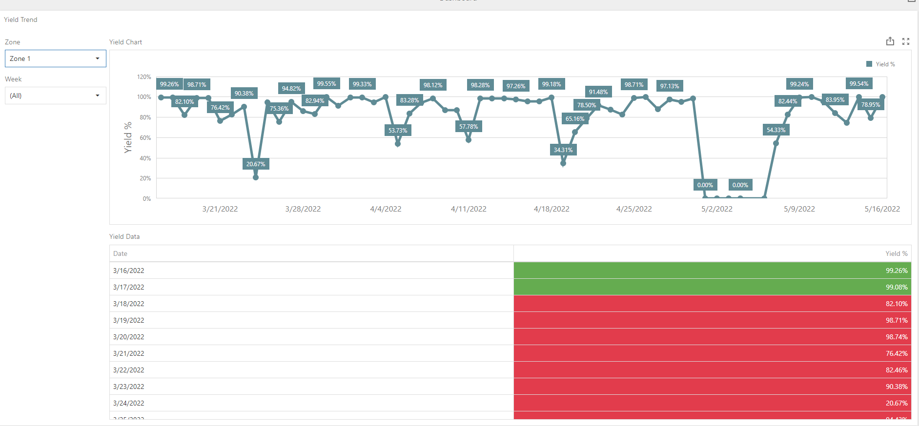
Yield Chart
Zone 1
Zone 2.1
Zone 2.2
Zone 3

Slide 27
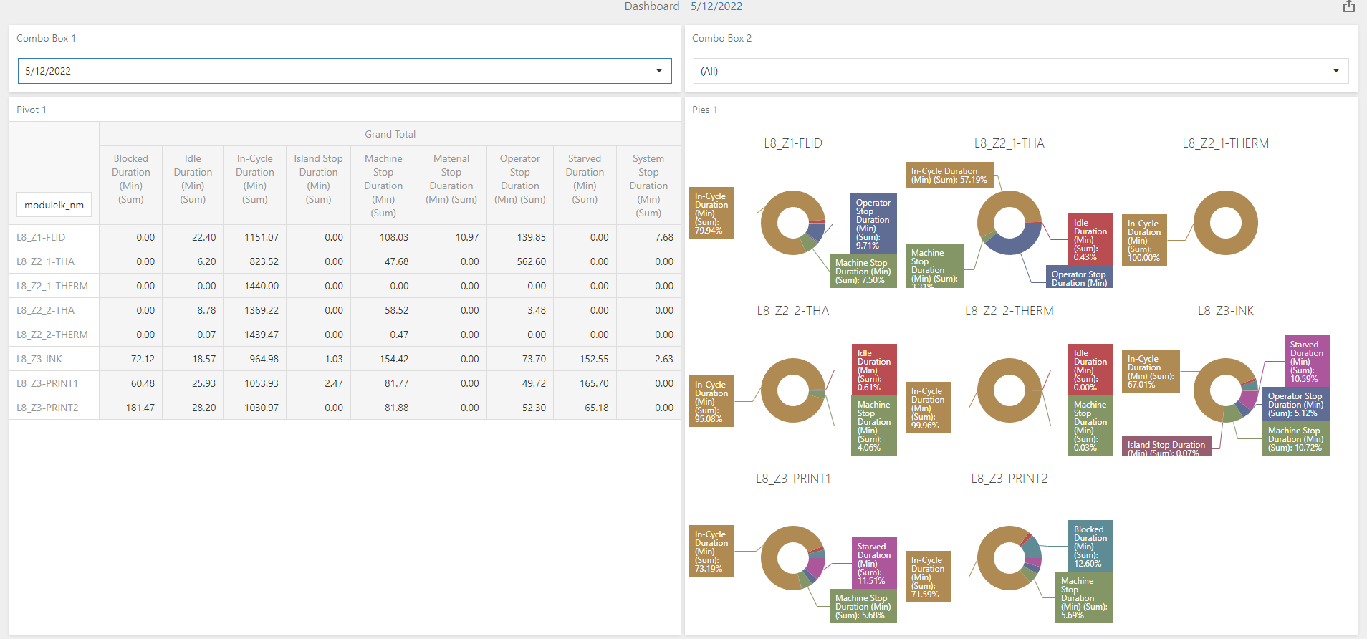
Zone Duration
(New) (Pie Chart)

Slide 28
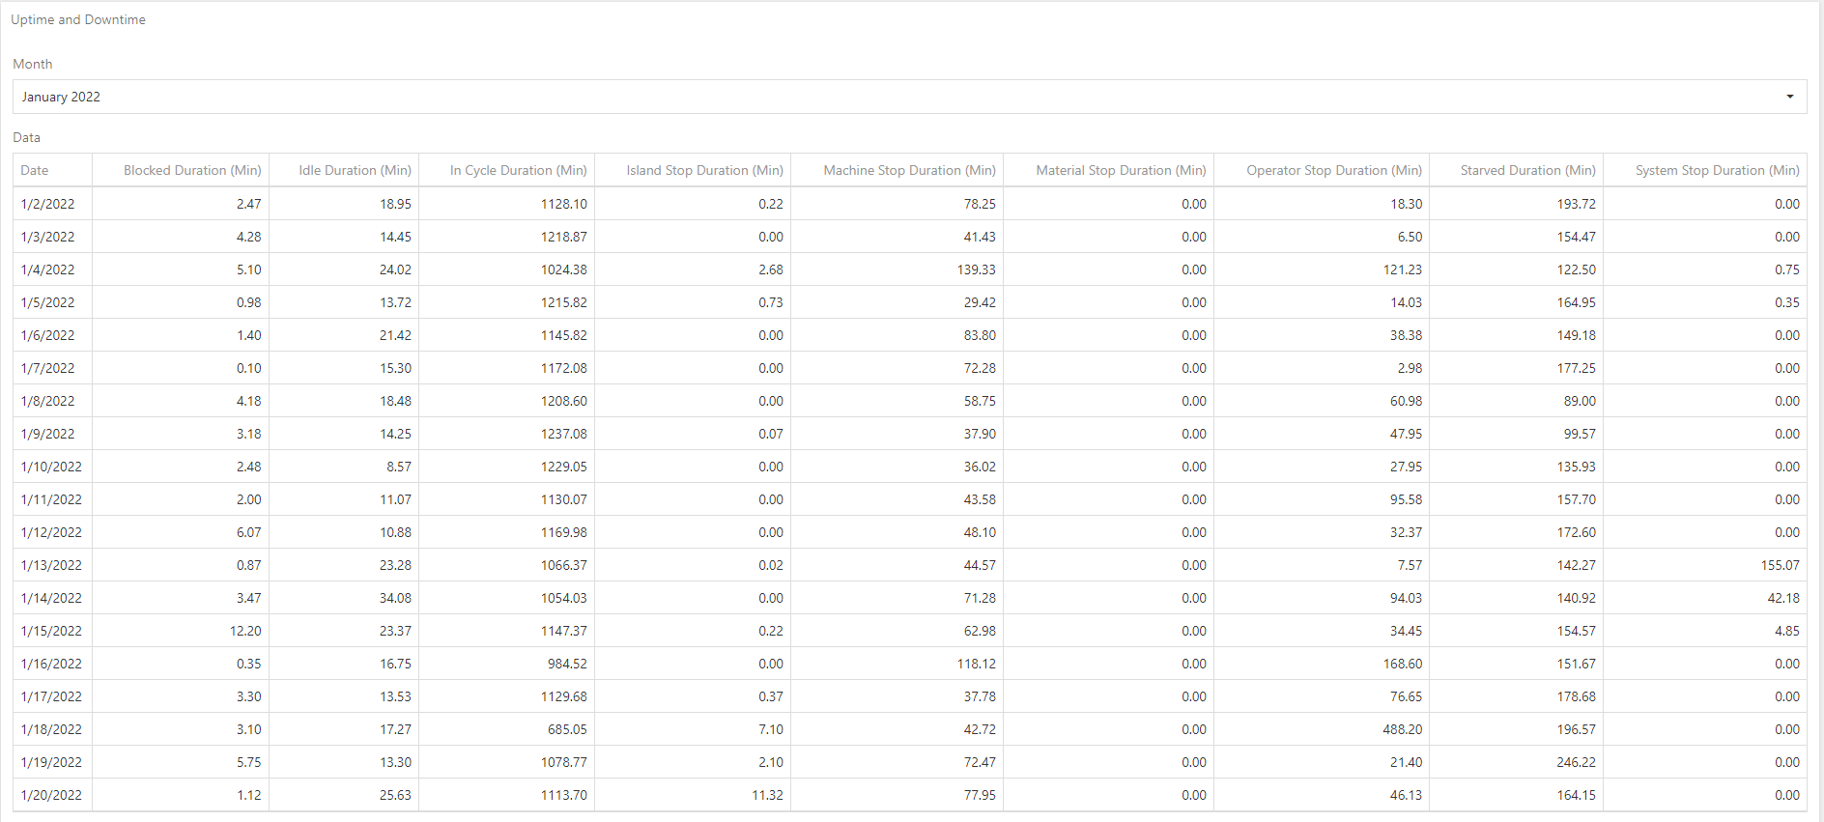
Monthly Uptime/Downtime (New)

Slide 29

Output by Product(by Shift)
Zone 1
Zone 2.1
Zone 2.2
Zone 3

Slide 30

Hourly and Weekly Output by Product
Zone 1
Zone 2.1
Zone 2.2
Zone 3

Slide 31
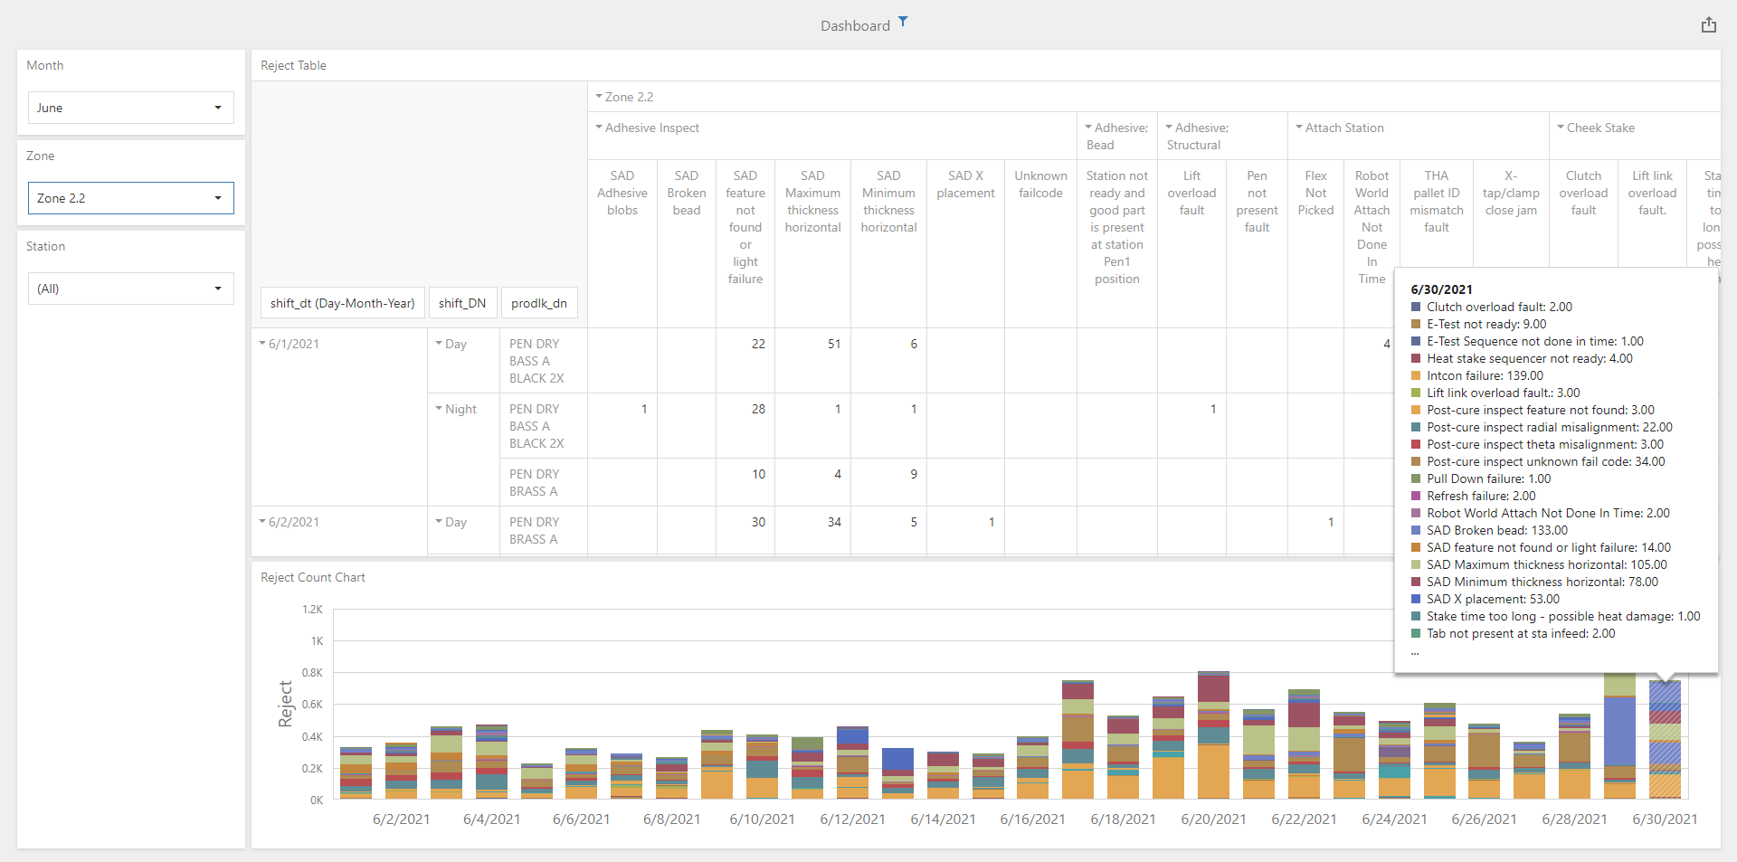
Reject Report
Zone 1
Zone 2.1
Zone 2.2
Zone 3

Slide 32
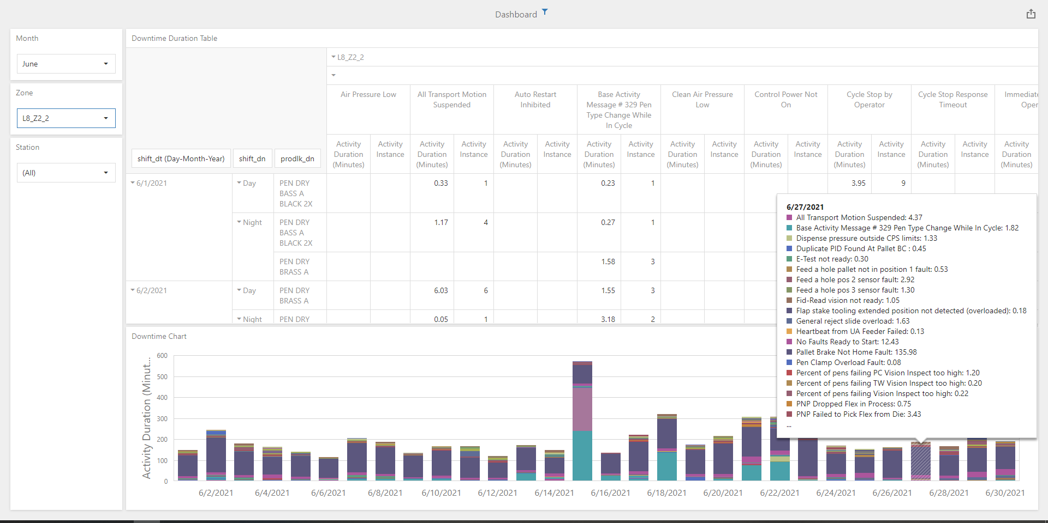
Downtime Report
Zone 1
Zone 2.1
Zone 2.2
Zone 3

Slide 33
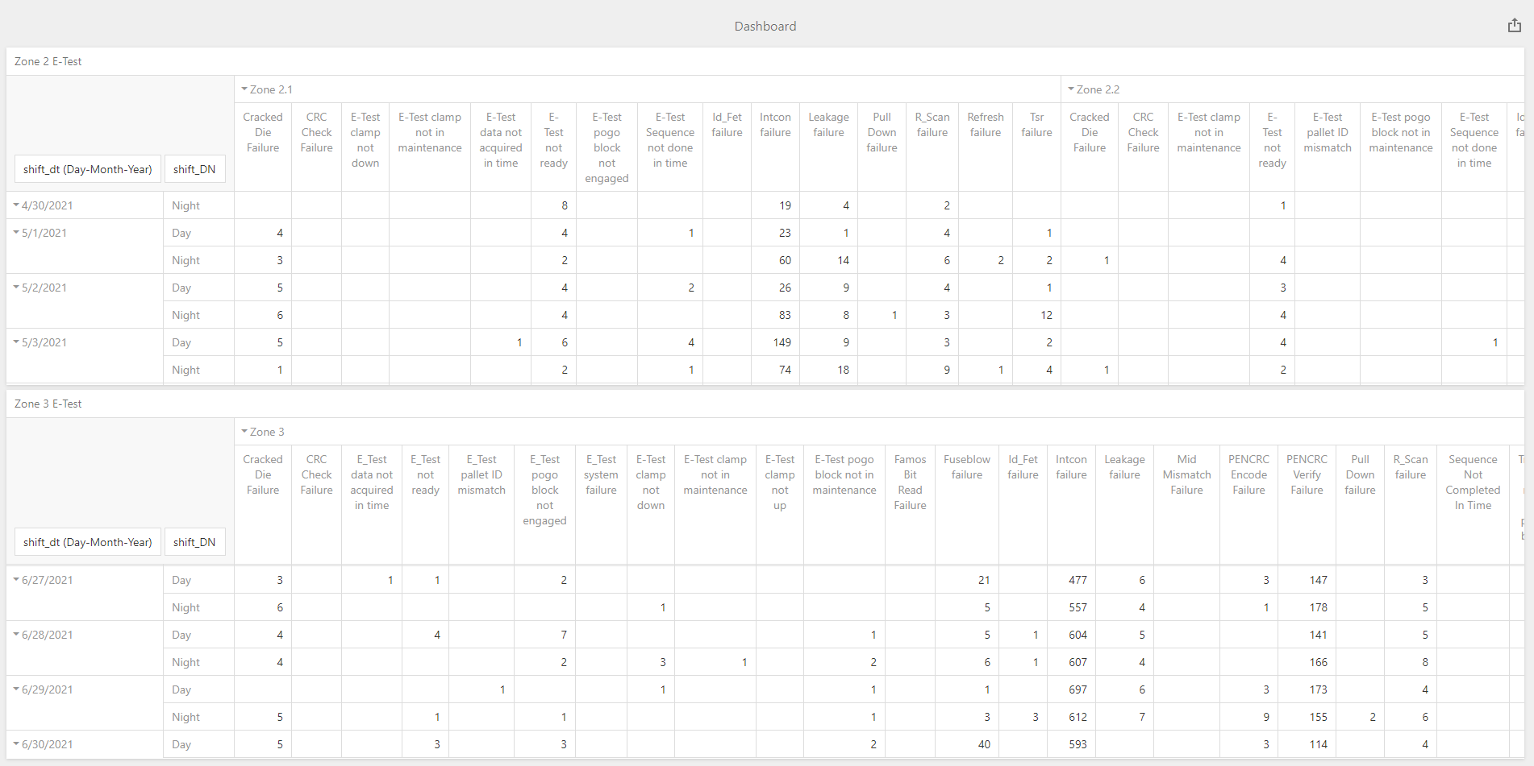
E-Test Report
Zone 2.1
Zone 2.2
Zone 3

Slide 34

Top 5 Reject Report
Daily
Weekly
Monthly
Daily (w/o Station)
Weekly (w/o Station)
Monthly (w/o Station)

Slide 35

Top 5 Downtime Report
Daily
Weekly
Monthly
Daily (w/o Station)
Weekly (w/o Station)
Monthly (w/o Station)

